Slide 1


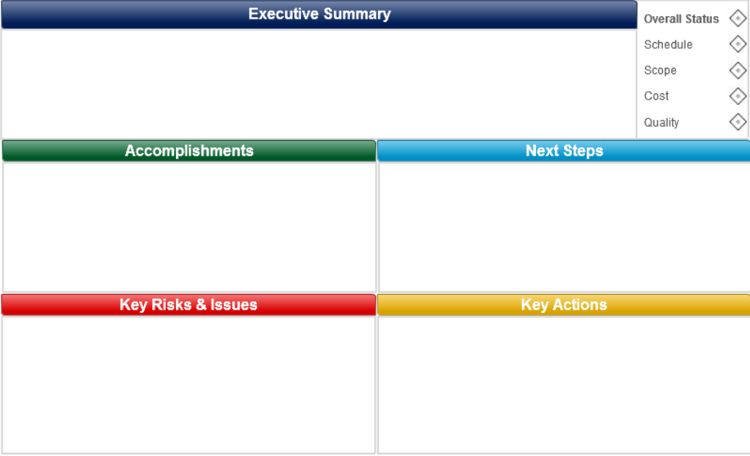
PROJECT: IIR FE Developer: Martín Rodríguez REPORT DATE: 13/04/2018 – W15
Progress: 2%
FINANCIALS (KUSD)
The scope was defined
Project documentation was updated
N/A at this momment
Scope and documentation were established
Pending Tasks:
After finish IPCT, begin develop
Support Needed
N/A at this momment

